Slide 1

Cross-Platform Ray Tracing Benchmarking Ray Tracing Performance on Windows, Linux and macOS/iOS
Manas Kulkarni Wolfgang Engel June 17th, 2020

Slide 2


Slide 3
Agenda
Overview The Forge
Cross-Platform Ray Tracing
Demo and Performance Numbers
Future Development
Support

Slide 4
Overview The Forge
Cross-Platform Rendering and Ray Tracing Framework for all platforms
https://github.com/ConfettiFX/The-Forge
“Easy” “Drag&Drop” replacement for game engines rendering framework ☺
Add new target platforms to game engines is one of our typical tasks

Slide 5
Overview The Forge
PC
Windows 10
with DirectX 12 / Vulkan 1.1
with DirectX Ray Tracing API
DirectX 11 for Windows 7 support
Linux Ubuntu 18.04 LTS with Vulkan 1.1 and RTX Ray Tracing API
Android Pie with Vulkan 1.1
macOS / iOS / iPad OS with Metal 2.2
XBOX all of them (only available for accredited developers on request)
PS4 / PS4 Pro (only available for accredited developers on request)
PS5 (only available for accredited developers on request)
Switch (only available for accredited developers on request)
Google Stadia (only available for accredited developers on request)

Slide 6
Motivation
Why would someone want to use a cross-platform rendering framework? -> reach more gamers with different hardware preferences -> Re-use art assets on as many platforms as possible to amortize the cost of art asset creation -> ROI is reached faster

Slide 7
Setup
git clone https://github.com/ConfettiFX/The-Forge.git
cd The-Forge
./PRE_BUILD.bat (On Windows)
./PRE_BUILD.command (On other platforms)
# double-click The-Forge\Examples_3\Unit_Tests\PC Visual Studio 2017\Unit_Tests.sln
# build DebugDx

Slide 8
Cross-Platform Ray Tracing
High-level view on the various APIs:
DirectX offers DXR, a dedicated API for writing hardware-accelerated Ray Tracing applications
Vulkan offers RTX which is very similar to DXR
macOS / iOS offers MPSRayIntersector, which lets you pass in an array of rays and returns an array of intersections which are calculated on the GPU

Slide 9
Cross-Platform Ray Tracing
The Forge wants to make it as easy as possible to create cross-platform apps
Our Ray Tracing interface is similar to DXR / RTX
We added functionality on top of Metal to offer the same feature set as DXR / RTX through the same interface

Slide 10
Cross-Platform Ray Tracing
API_INTERFACE bool FORGE_CALLCONV isRaytracingSupported(Renderer* pRenderer);
API_INTERFACE bool FORGE_CALLCONV initRaytracing(Renderer* pRenderer, Raytracing** ppRaytracing);
API_INTERFACE void FORGE_CALLCONV removeRaytracing(Renderer* pRenderer, Raytracing* pRaytracing);
/// pScratchBufferSize - Holds the size of scratch buffer to be passed to cmdBuildAccelerationStructure
API_INTERFACE void FORGE_CALLCONV addAccelerationStructure(Raytracing* pRaytracing, const AccelerationStructureDescTop* pDesc, AccelerationStructure** ppAccelerationStructure);
API_INTERFACE void FORGE_CALLCONV removeAccelerationStructure(Raytracing* pRaytracing, AccelerationStructure* pAccelerationStructure);
API_INTERFACE void FORGE_CALLCONV addRaytracingShaderTable(Raytracing* pRaytracing, const RaytracingShaderTableDesc* pDesc, RaytracingShaderTable** ppTable);
API_INTERFACE void FORGE_CALLCONV removeRaytracingShaderTable(Raytracing* pRaytracing, RaytracingShaderTable* pTable);
API_INTERFACE void FORGE_CALLCONV cmdBuildAccelerationStructure(Cmd* pCmd, Raytracing* pRaytracing, RaytracingBuildASDesc* pDesc);
API_INTERFACE void FORGE_CALLCONV cmdDispatchRays(Cmd* pCmd, Raytracing* pRaytracing, const RaytracingDispatchDesc* pDesc);
#ifdef METAL
API_INTERFACE void FORGE_CALLCONV addSSVGFDenoiser(Renderer* pRenderer, SSVGFDenoiser** ppDenoiser);
API_INTERFACE void FORGE_CALLCONV removeSSVGFDenoiser(SSVGFDenoiser* pDenoiser);
API_INTERFACE void FORGE_CALLCONV clearSSVGFDenoiserTemporalHistory(SSVGFDenoiser* pDenoiser);
API_INTERFACE void FORGE_CALLCONV cmdSSVGFDenoise(Cmd* pCmd, SSVGFDenoiser* pDenoiser, Texture* pSourceTexture, Texture* pMotionVectorTexture, Texture* pDepthNormalTexture, Texture* pPreviousDepthNormalTexture, Texture** ppOut);
#endif

Slide 11
Cross-Platform Ray Tracing
DXR / RTX in 30 seconds
Dispatch a set of rays through a Ray-Generation shader, and test intersection against an Acceleration Structure
Intersection test can be done using the fixed function triangle intersection shader as well as a programmable AABB intersection shader

Slide 12
Cross-Platform Ray Tracing
DXR / RTX in 30 seconds continued:
When intersections are encountered, hit shaders get involved: Closest-Hit or Any-Hit
Closest-Hit shader:
executes code similar to your typical material pixel shader
can also dispatch more rays for effects such as shadow, indirect lighting
Any-Hit shaders: are used to decide whether to continue the ray trace or accept the current hit and end the search. This is useful for alpha-testing, simple shadow effects etc.

Slide 13
Cross-Platform Ray Tracing
DXR / RTX in 30 seconds continued:
In case the ray hits nothing, the miss shader gets invoked -> used for filling the background with a skybox, solid color etc.
The control flow between shaders is recursive -> everything ends up back at the ray generation shader

Slide 14
Cross-Platform Ray Tracing
Metal Raytracing only supports ray intersections and does not support recursion within shaders
To support a DXR style interface on the app level we implemented tail recursion for Metal

Slide 15
Cross-Platform Ray Tracing
Metal Raytracing – tail recursion
To find out which shader to run for each intersection, we first run a Classification Shader -> assigns each ray / pixel its next shader -> stores for each ray / pixel the shader indices in a Shader Index Buffer
A radix sort shader sorts the Shader Index buffer

Slide 16
Cross-Platform Ray Tracing
Metal Raytracing – tail recursion
From the Shader Index Buffer an Offset Buffer is generated using the offset generation shader -> holds the offset between the first ray and last ray for each shader

Slide 17
Cross-Platform Ray Tracing
Metal Raytracing – tail recursion
Then for each shader an Indirect Buffer containing the offset, count, and number of thread groups is generated:
uint32_t indirect[5]
indirect[0] // Index of First ray for the shader
indirect[1] // Number of rays for the shader
indirect[2-4]// Actual indirect dispatch argument // (thread group count where y and z // are always 1 so the shader performs // in 1 dimension)

Slide 18
Cross-Platform Ray Tracing
Metal Raytracing
Finally, we dispatch all shaders using the Indirect Buffer
If there are no active rays for a shader it will early out before the shader runs, minimizing the overhead

Slide 19
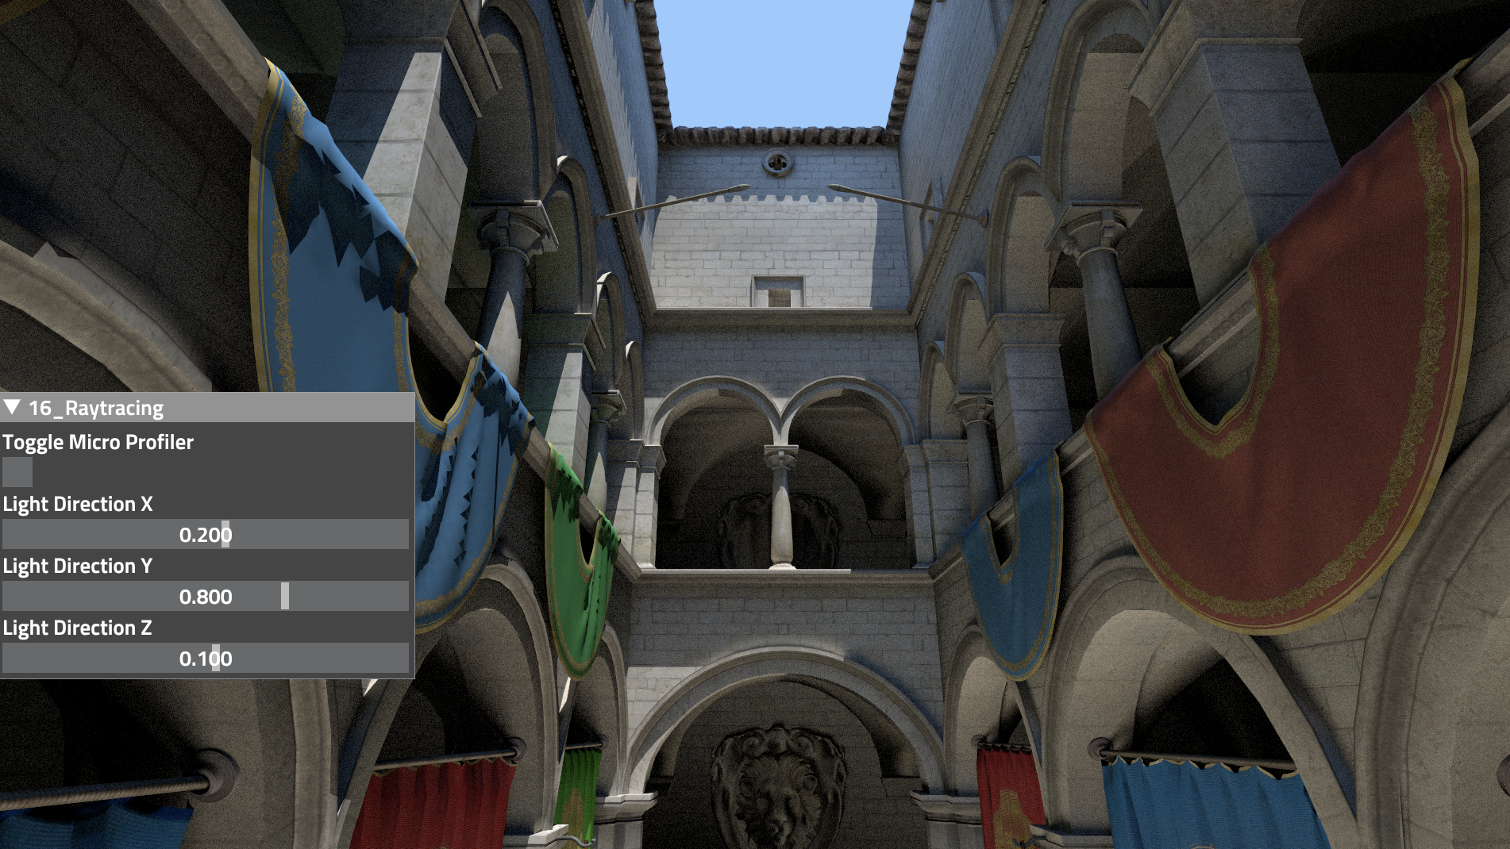
Sponza Path Tracer Demo
Notes:
- Descriptors: Descriptors or views describe and point to resources == block of data in memory
They use a GPU-specific opaque format
typedef struct VkGraphicsPipelineCreateInfo {
VkStructureType sType;
const void* pNext;
VkPipelineCreateFlags flags;
uint32_t stageCount;
const VkPipelineShaderStageCreateInfo* pStages;
const VkPipelineVertexInputStateCreateInfo* pVertexInputState;
const VkPipelineInputAssemblyStateCreateInfo* pInputAssemblyState;
const VkPipelineTessellationStateCreateInfo* pTessellationState;
const VkPipelineViewportStateCreateInfo* pViewportState;
const VkPipelineRasterizationStateCreateInfo* pRasterizationState;
const VkPipelineMultisampleStateCreateInfo* pMultisampleState;
const VkPipelineDepthStencilStateCreateInfo* pDepthStencilState;
const VkPipelineColorBlendStateCreateInfo* pColorBlendState;
const VkPipelineDynamicStateCreateInfo* pDynamicState;
VkPipelineLayout layout;
VkRenderPass renderPass;
uint32_t subpass;
VkPipeline basePipelineHandle;
int32_t basePipelineIndex;
} VkGraphicsPipelineCreateInfo;
VkResult vkCreatePipelineLayout(
VkDevice device,
const VkPipelineLayoutCreateInfo* pCreateInfo,
const VkAllocationCallbacks* pAllocator,
VkPipelineLayout* pPipelineLayout);
typedef struct VkPipelineLayoutCreateInfo {
VkStructureType sType;
const void* pNext;
VkPipelineLayoutCreateFlags flags;
uint32_t setLayoutCount;
const VkDescriptorSetLayout* pSetLayouts;
uint32_t pushConstantRangeCount;
const VkPushConstantRange* pPushConstantRanges;
} VkPipelineLayoutCreateInfo;

Slide 20
Overview
Features
Raytraced Shadows
One bounce Indirect lighting
macOS/iOS denoiser
Closest Hit shader dispatches additional ray for Shadows and N number of rays for Indirect lighting based on the recursion depth
Miss shader outputs blue for sky

Slide 21
Performance Numbers
Windows 10 Direct3D12 – NVIDIA RTX 2080
Total CPU frame time – 6.29 milliseconds
Total GPU frame time – 6.09 milliseconds
GPU timers
Raytracing (Dispatch Rays) – 5.99 milliseconds
Copy to Swap chain – 0.09 milliseconds

Slide 22
Performance Numbers
Windows 10 Vulkan – NVIDIA RTX 2080
Total CPU frame time – 5.99 milliseconds
Total GPU frame time – 5.81 milliseconds
GPU timers
Raytracing (Dispatch Rays) – 5.71 milliseconds
Copy to Swap chain – 0.09 milliseconds

Slide 23
Performance Numbers
Ubuntu Vulkan – NVIDIA RTX 2080
Total CPU frame time – 5.15 milliseconds
Total GPU frame time – 4.81 milliseconds
GPU timers
Raytracing (Dispatch Rays) – 4.71 milliseconds
Copy to Swap chain – 0.09 milliseconds

Slide 24
Performance Numbers
macOS Metal – Radeon Pro 580
Total CPU frame time – 79.10 milliseconds
Total GPU frame time – 78.16 milliseconds
Raytracing (Dispatch Rays) – 78.09 milliseconds
MPSRayIntersector – ~20 milliseconds
Primary Closest Hit – 5.9 milliseconds
Shadow – 6.16 milliseconds
Primary Miss – 0.8 milliseconds
Primary Miss Shadow – 0.8 milliseconds
Secondary Closest Hit – 4.9 milliseconds
Secondary Miss – 0.8 milliseconds
Copy to Swap chain – 0.07 milliseconds

Slide 25
Performance Numbers
iOS Metal – iPhone XS Max
Total CPU frame time – 118.63 milliseconds
Total GPU frame time – 118.45 milliseconds

Slide 26
Future Development
Support the new Extensions allowing Ray Tracing outside of the “Black-Box” of DXR / RTX
Next-gen console support

Slide 27
Support
Ray Tracing Discord channel: https://discord.gg/ab9ATB
We use Skype internally, we support game developers who use The Forge also through Skype channels

Slide 28
Thanks
Any questions: please use the Discord channel or contact me:
wolf@conffx.com

